Slide 1
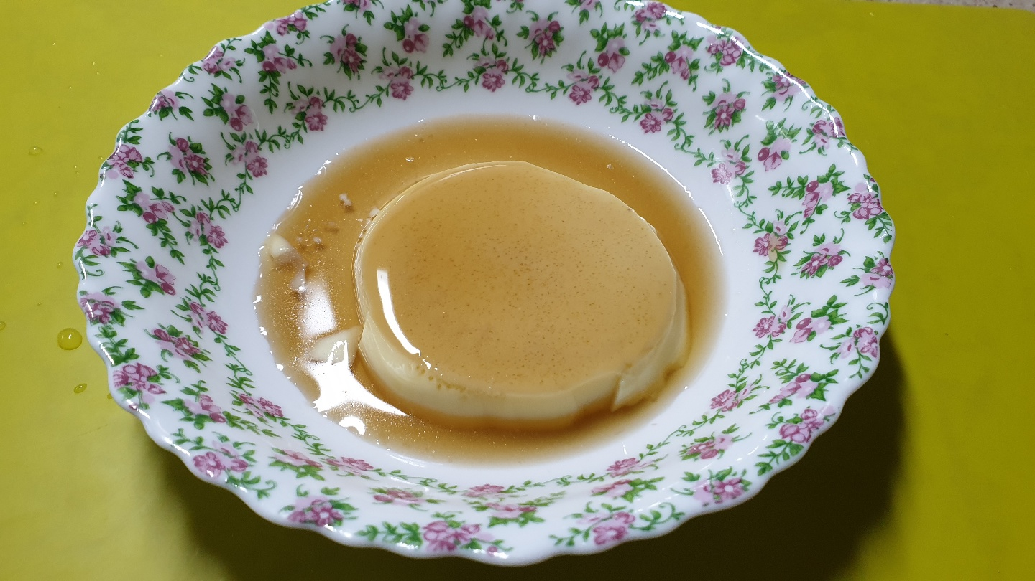
SPEAKING CE4 – 04 Subject : how to make a pudding
Name :
Kim Min-seok
Major :
Software

Slide 2
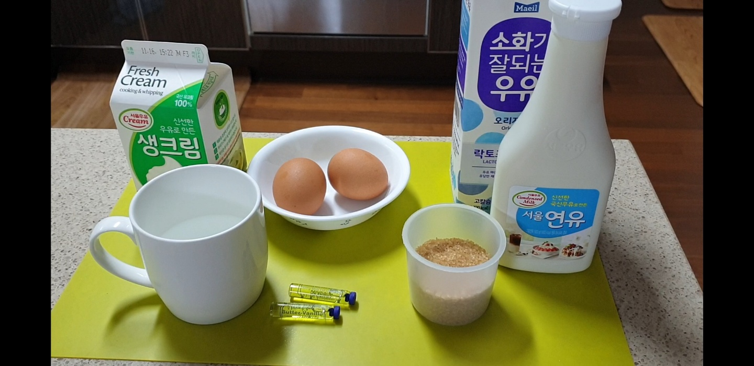
Whipping cream 70g
Milk 150g
Condensed milk 100g
2 Eggs
Water 45g
Sugar 75g
Vanilla extract 3g

Slide 3
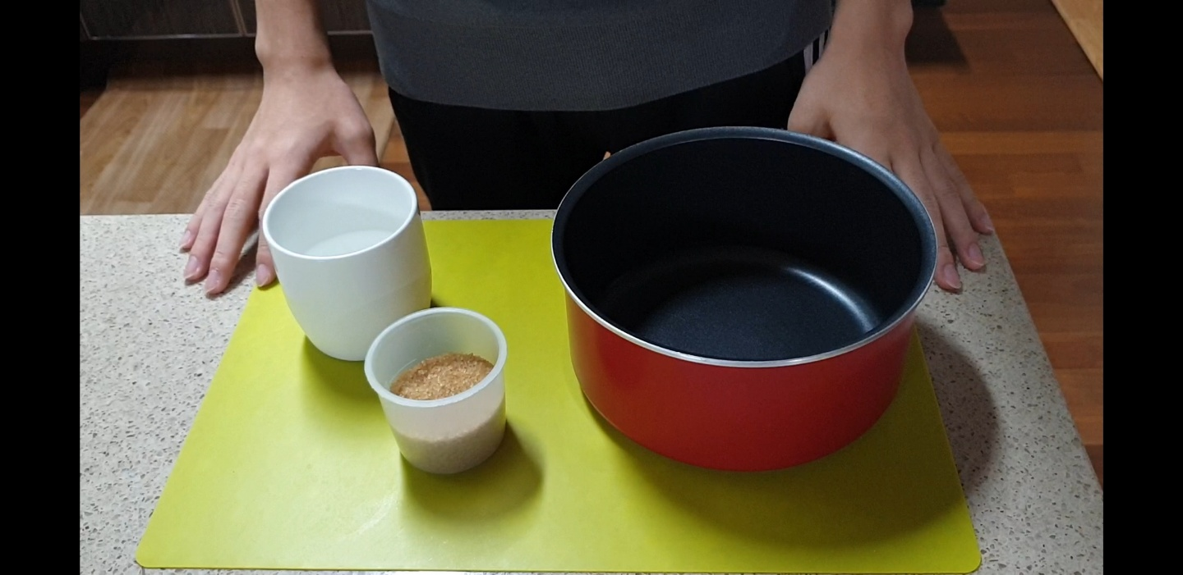
Pour water and sugar into a pot

Slide 4
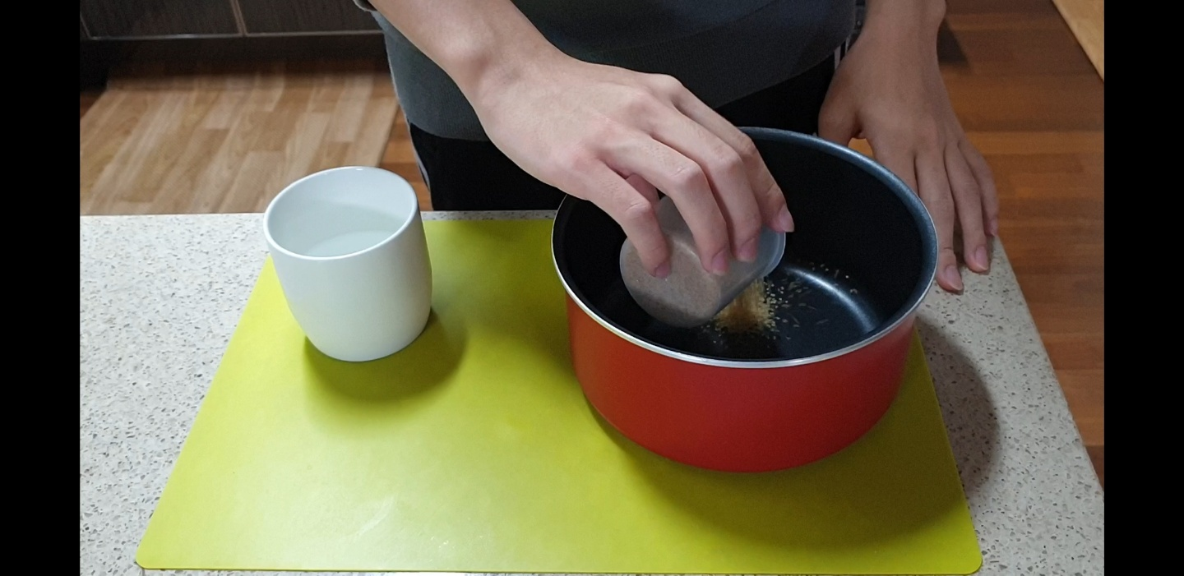
Pour water and sugar into a pot

Slide 5
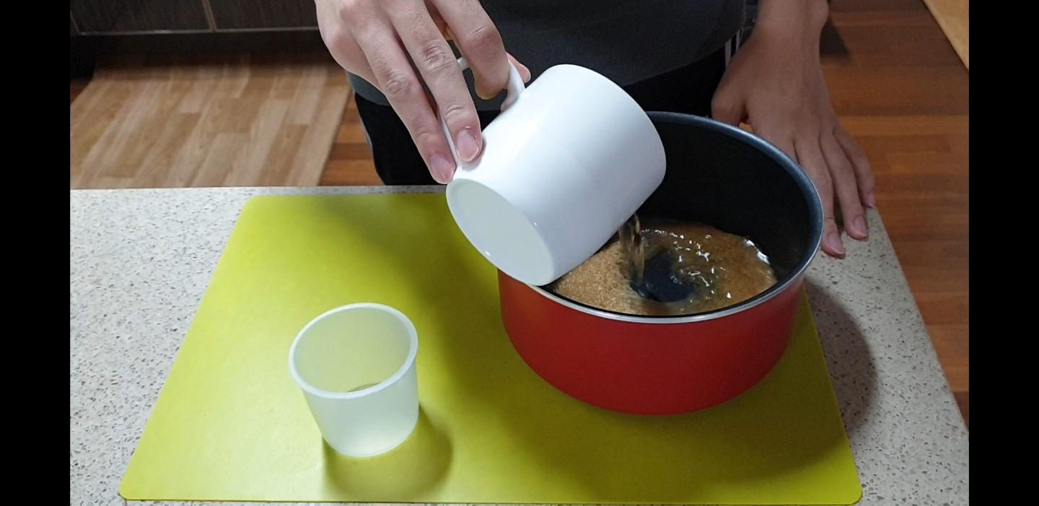
Pour water and sugar into a pot

Slide 6
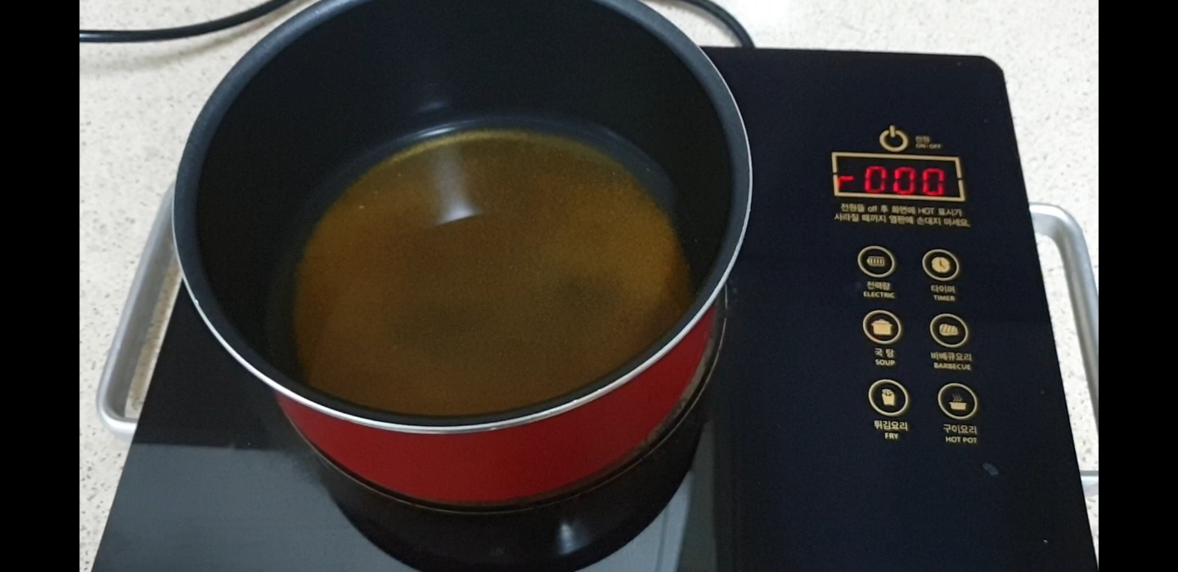
Boil until foam is gone and sticky syrup is formed.

Slide 7
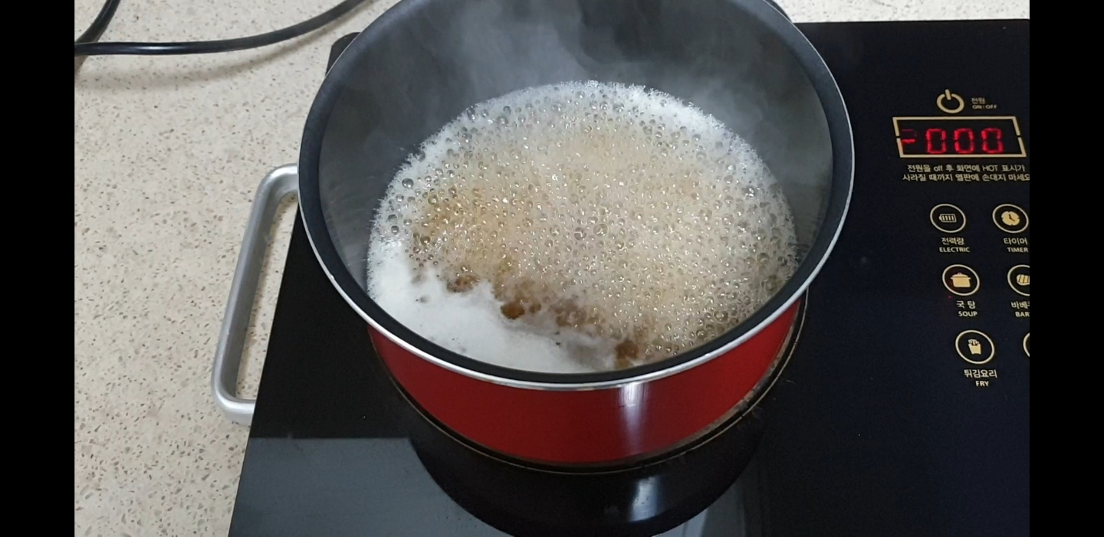
Boil until foam is gone and sticky syrup is formed.

Slide 8
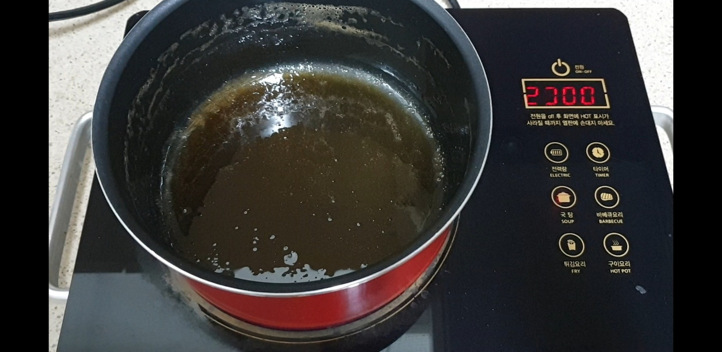
Boil until foam is gone and sticky syrup is formed.

Slide 9
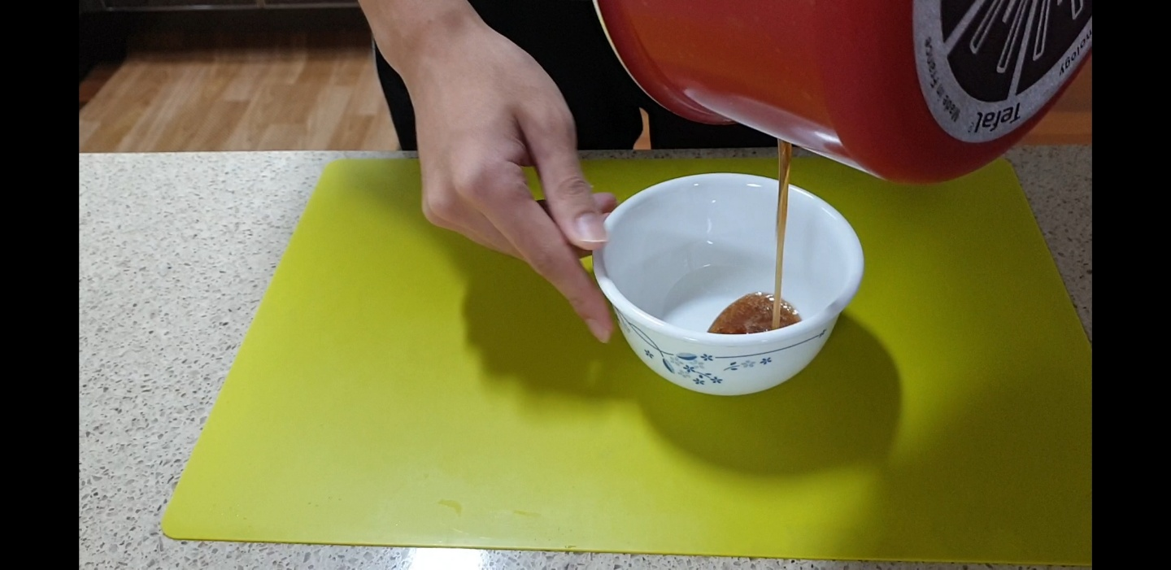
Put into a bowl and freeze in the fridge.

Slide 10
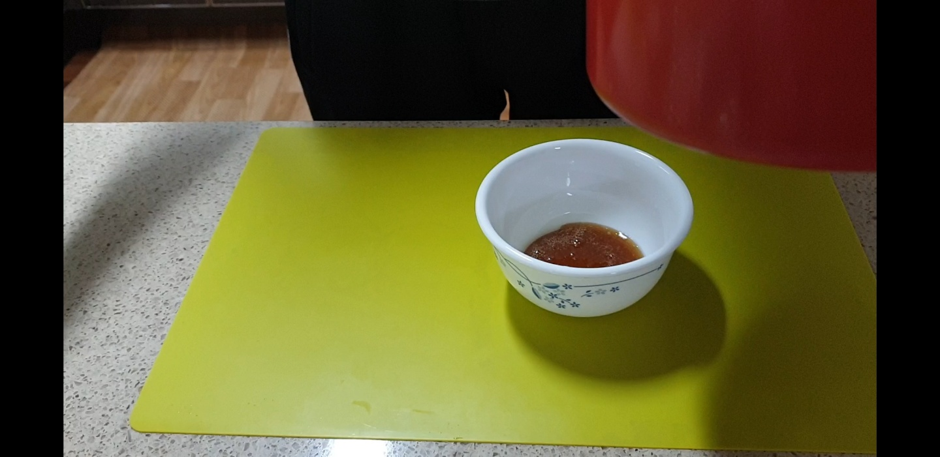
Put into a bowl and freeze in the fridge.

Slide 11
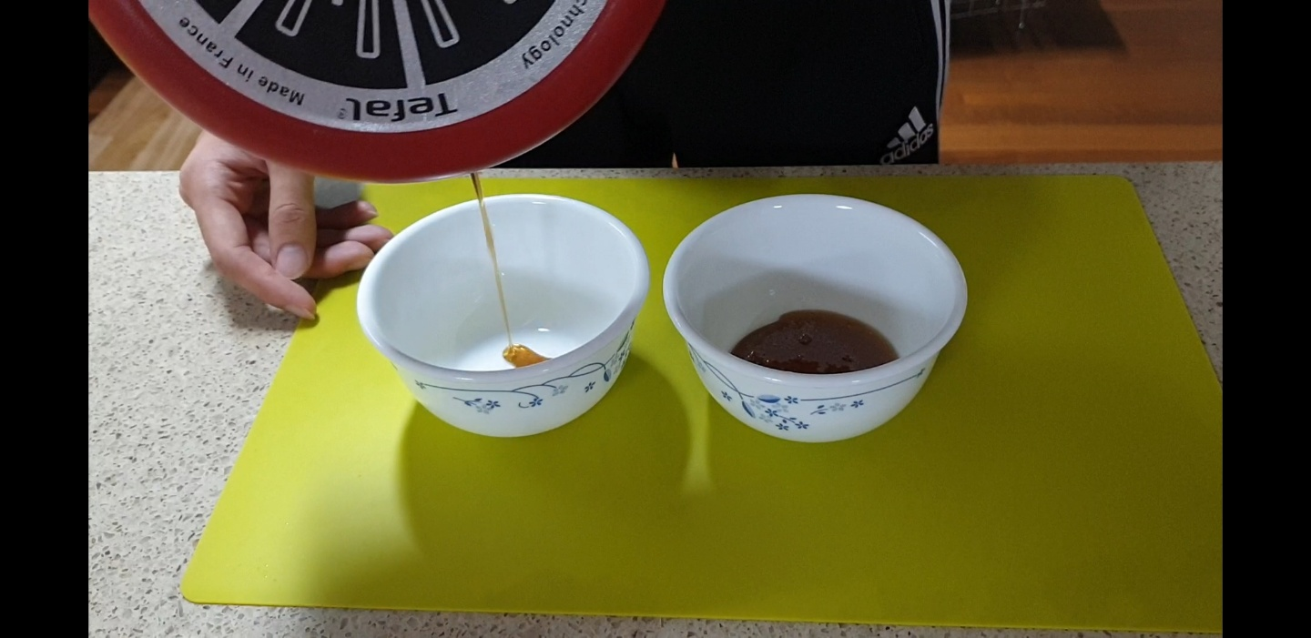
Put into a bowl and freeze in the fridge.

Slide 12
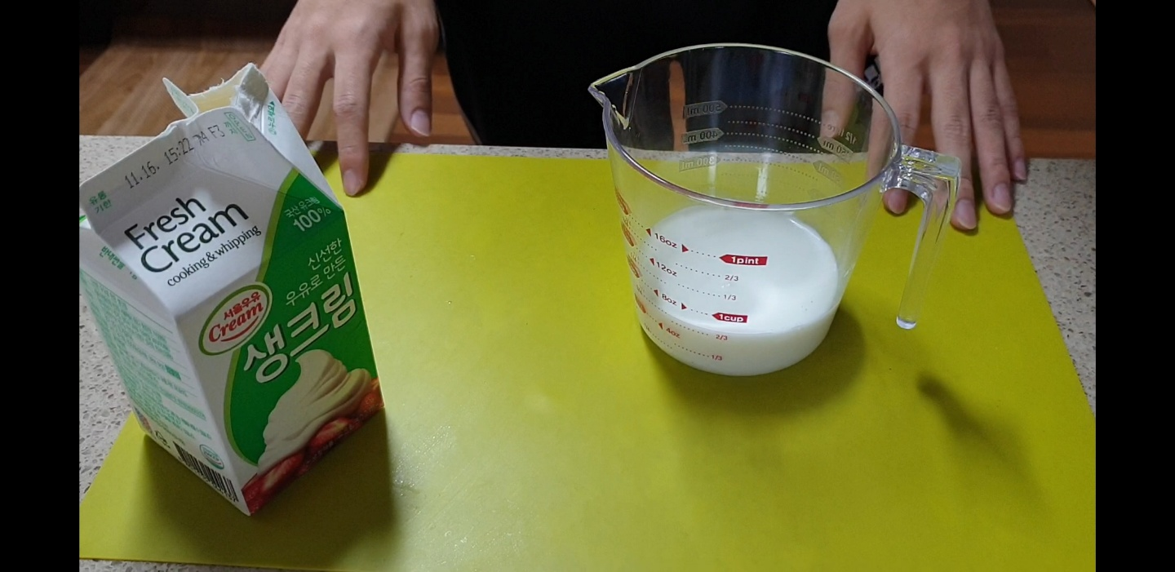
Mix milk and whipping cream.

Slide 13
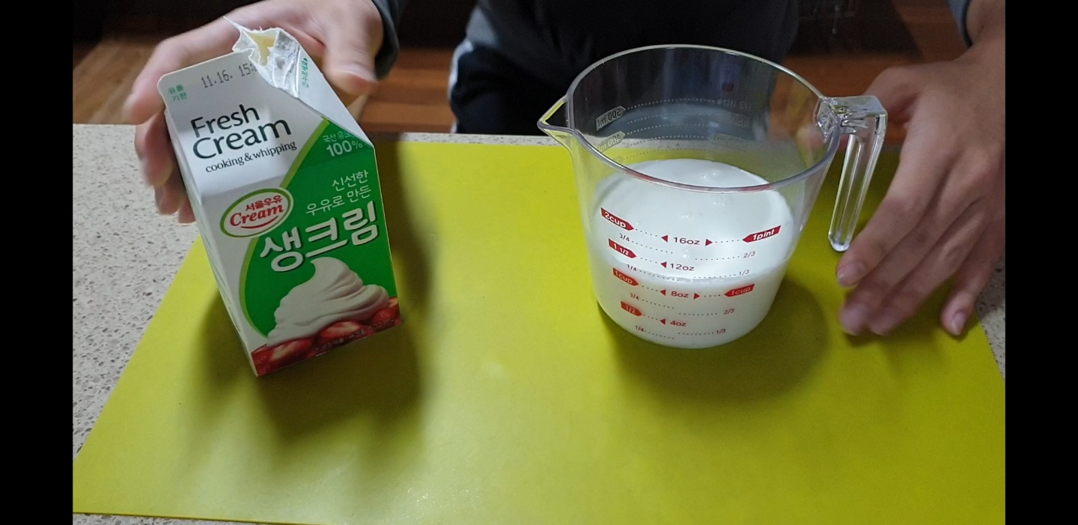
Mix milk and whipping cream.

Slide 14
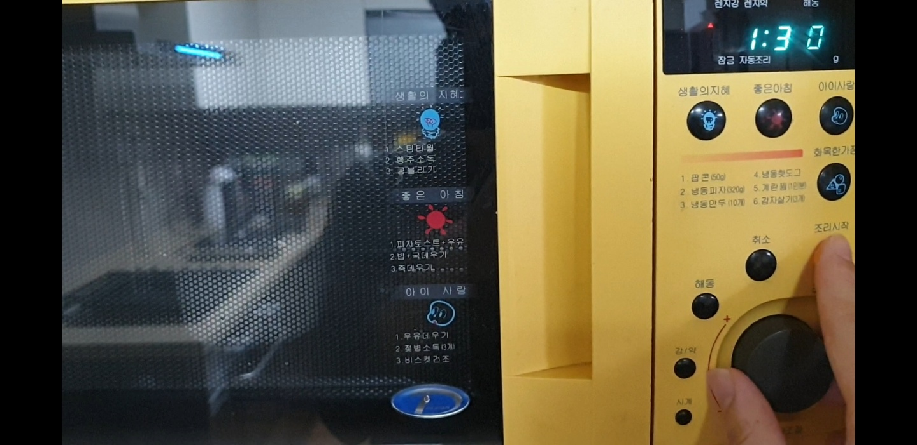
Microwave for 1 minutes 30 seconds.

Slide 15
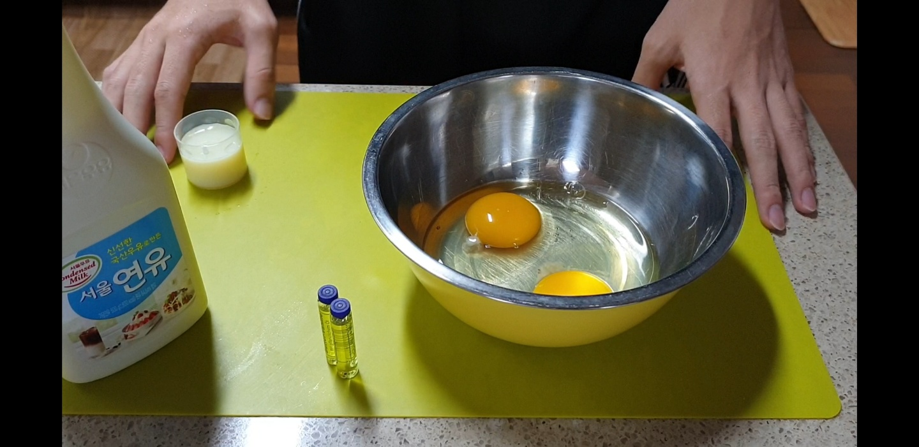
Put 2 eggs.

Slide 16
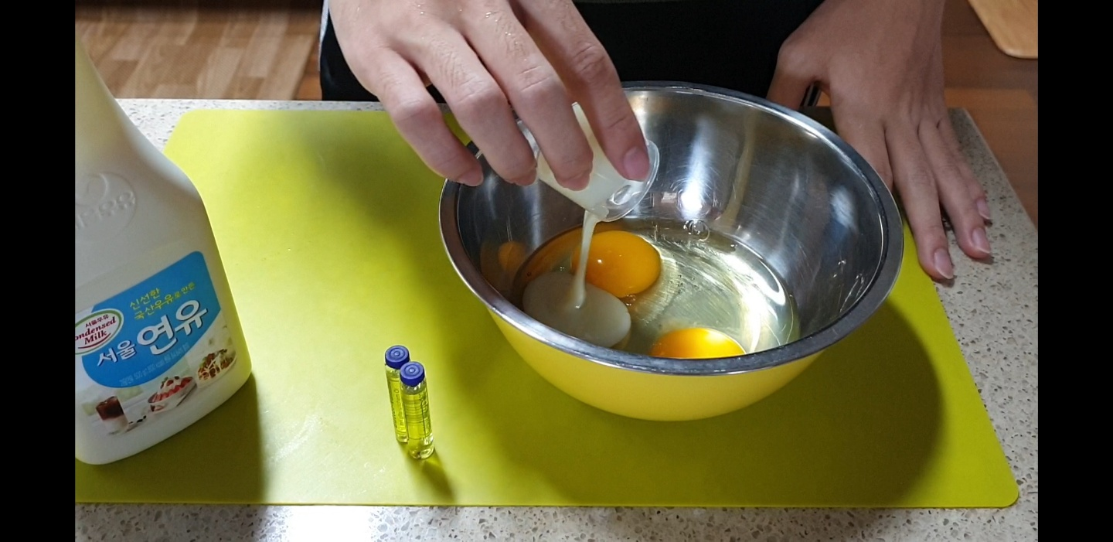
Put condensed milk.

Slide 17
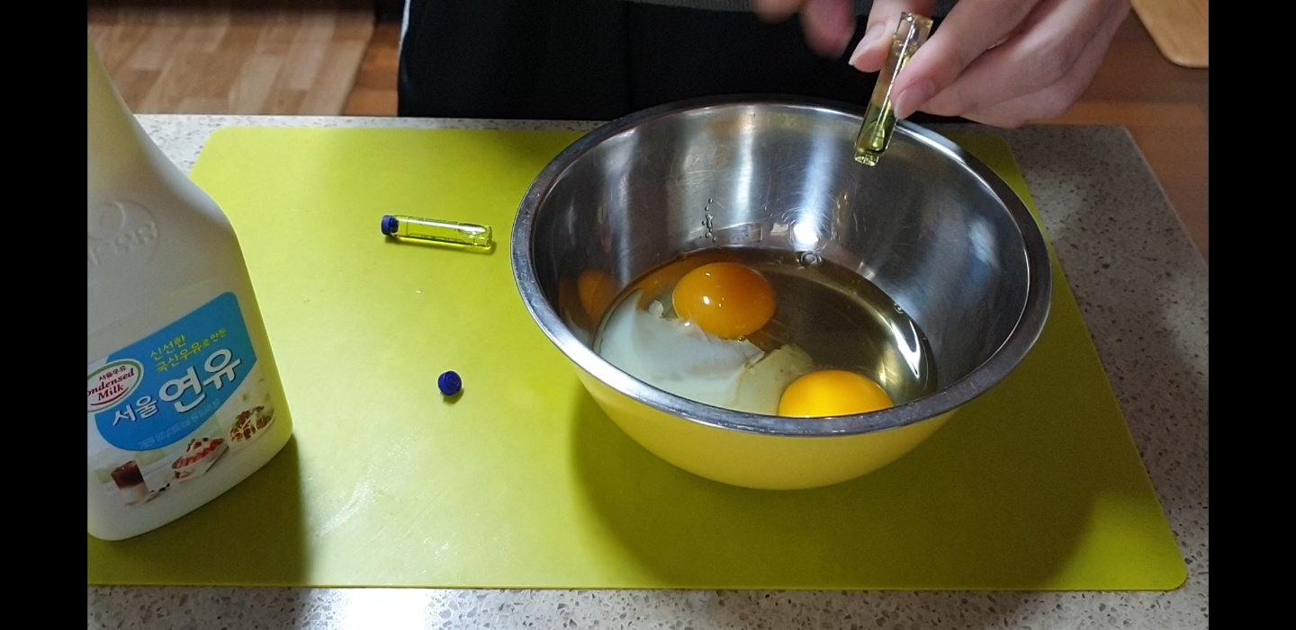
Put vanilla extract.

Slide 18
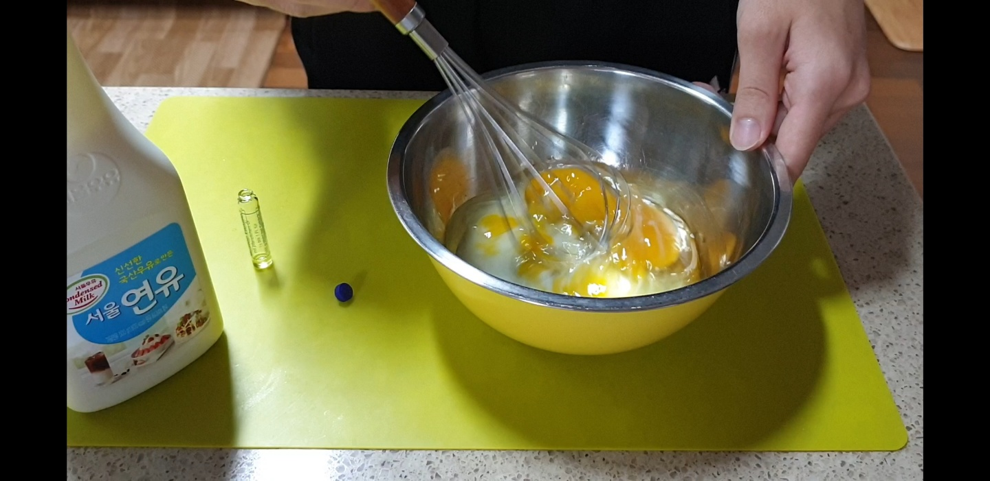
Mix !

Slide 19
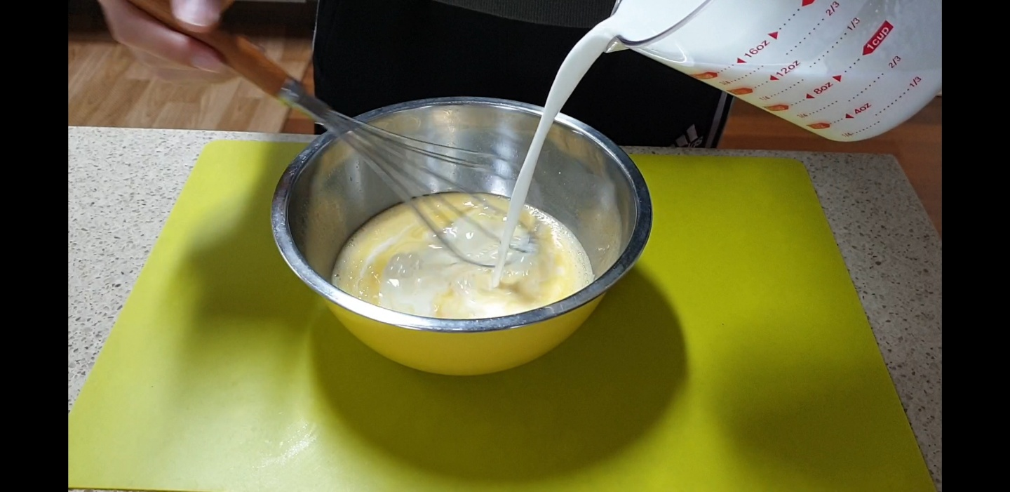
Blend with the prepared whipping cream milk.

Slide 20
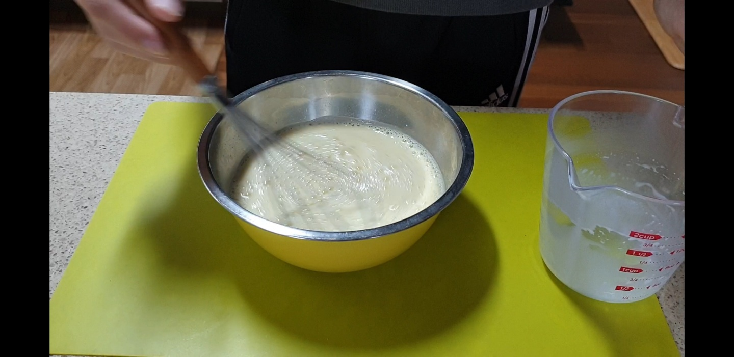
Stir it until the bubble.

Slide 21
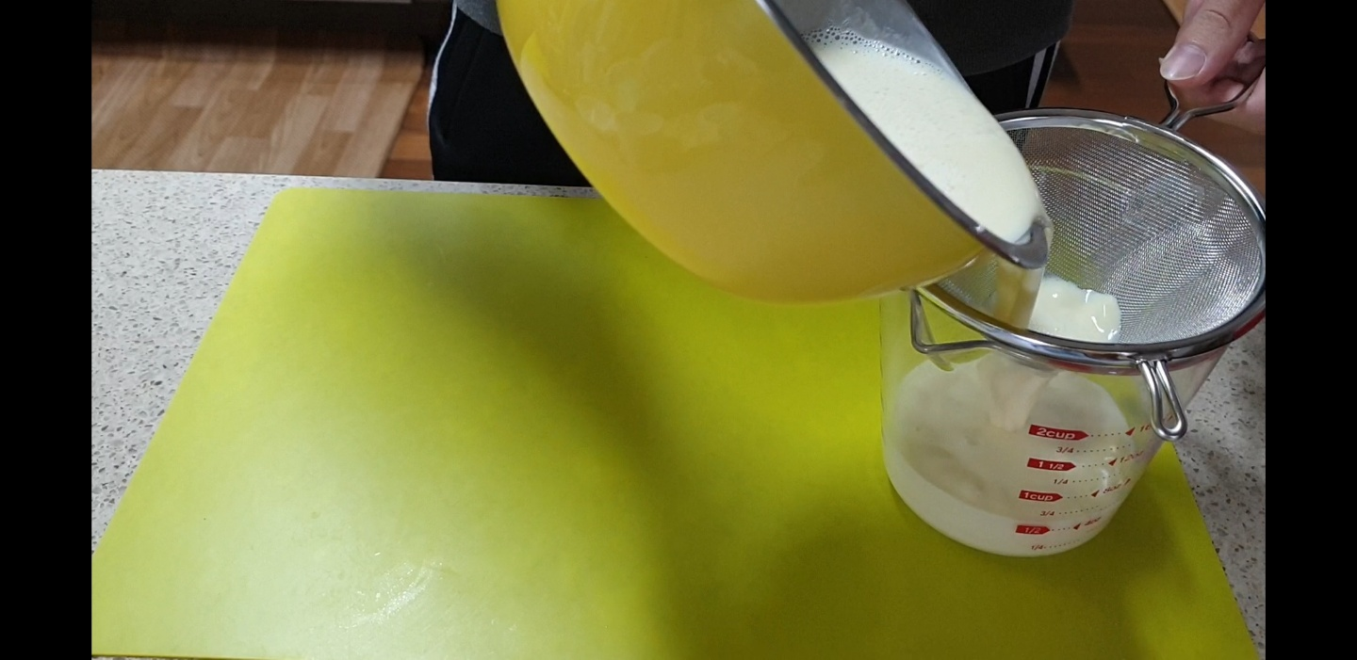
Remove foam.

Slide 22
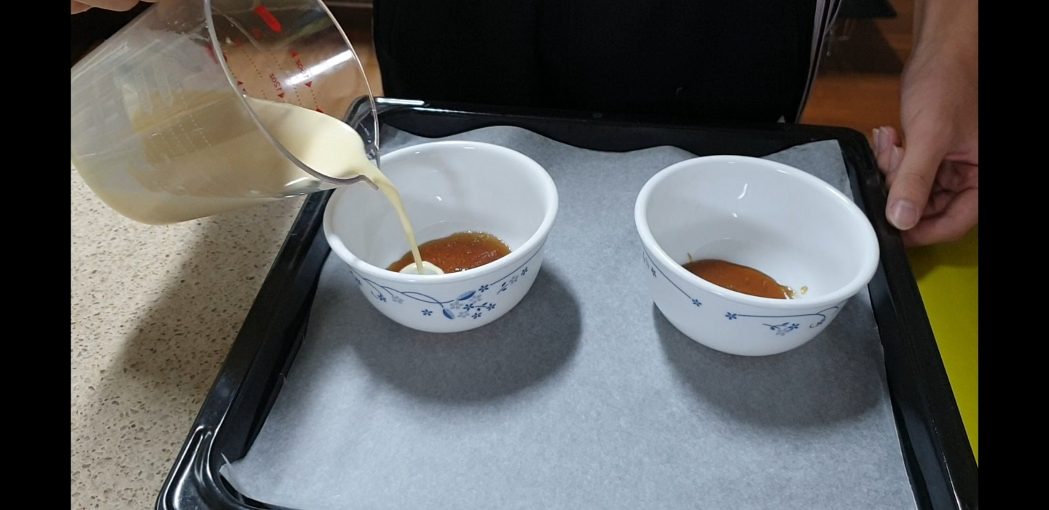
Put in the oven bowl.

Slide 23
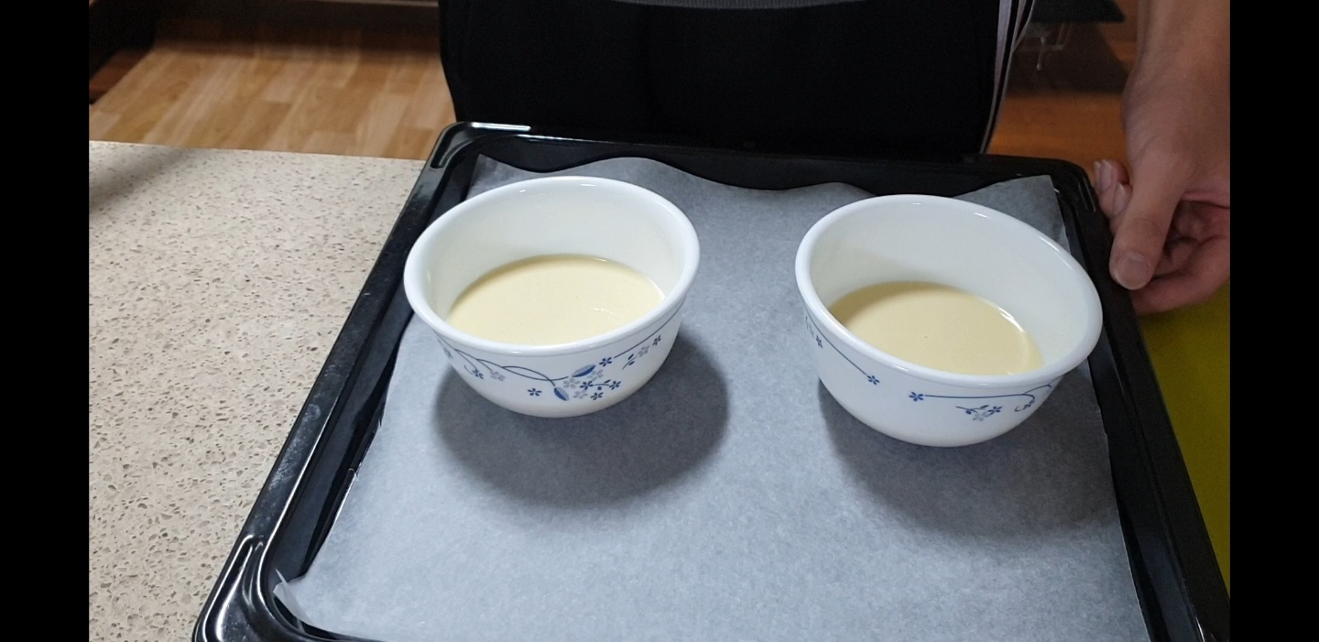
Place in the oven tray.

Slide 24
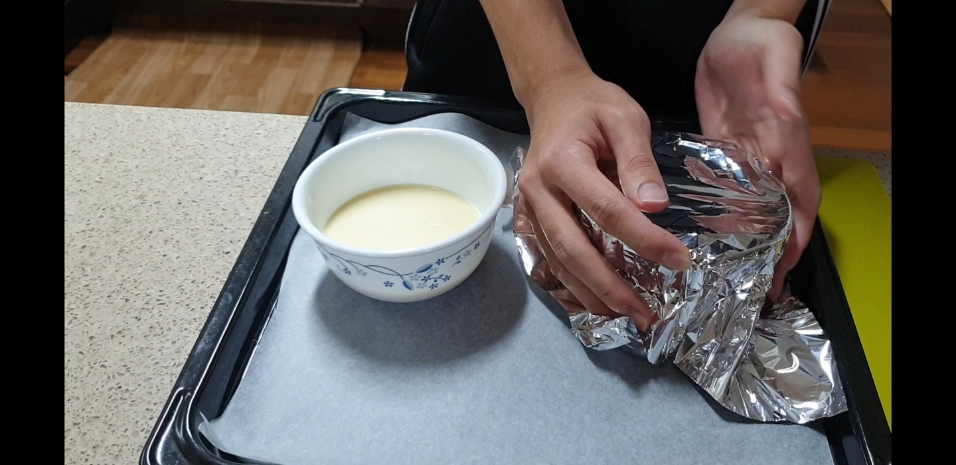
Cover with foil.

Slide 25
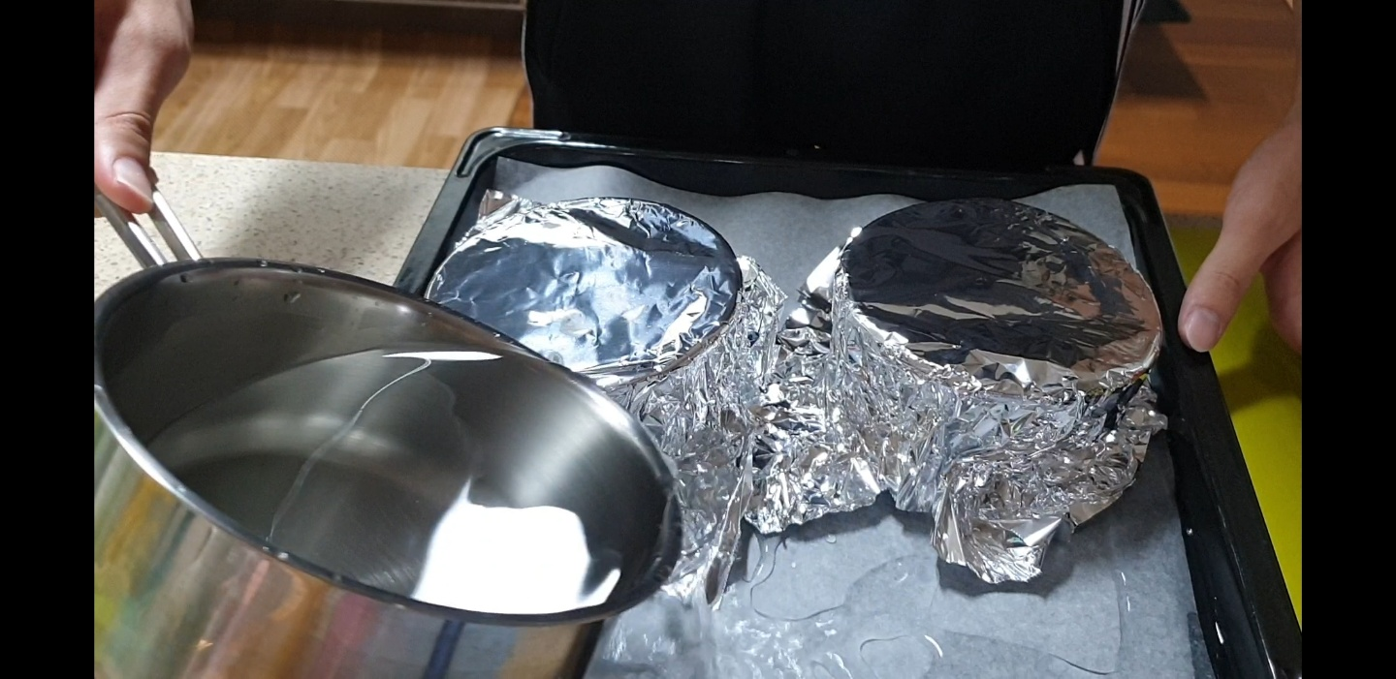
Add hot water.

Slide 26
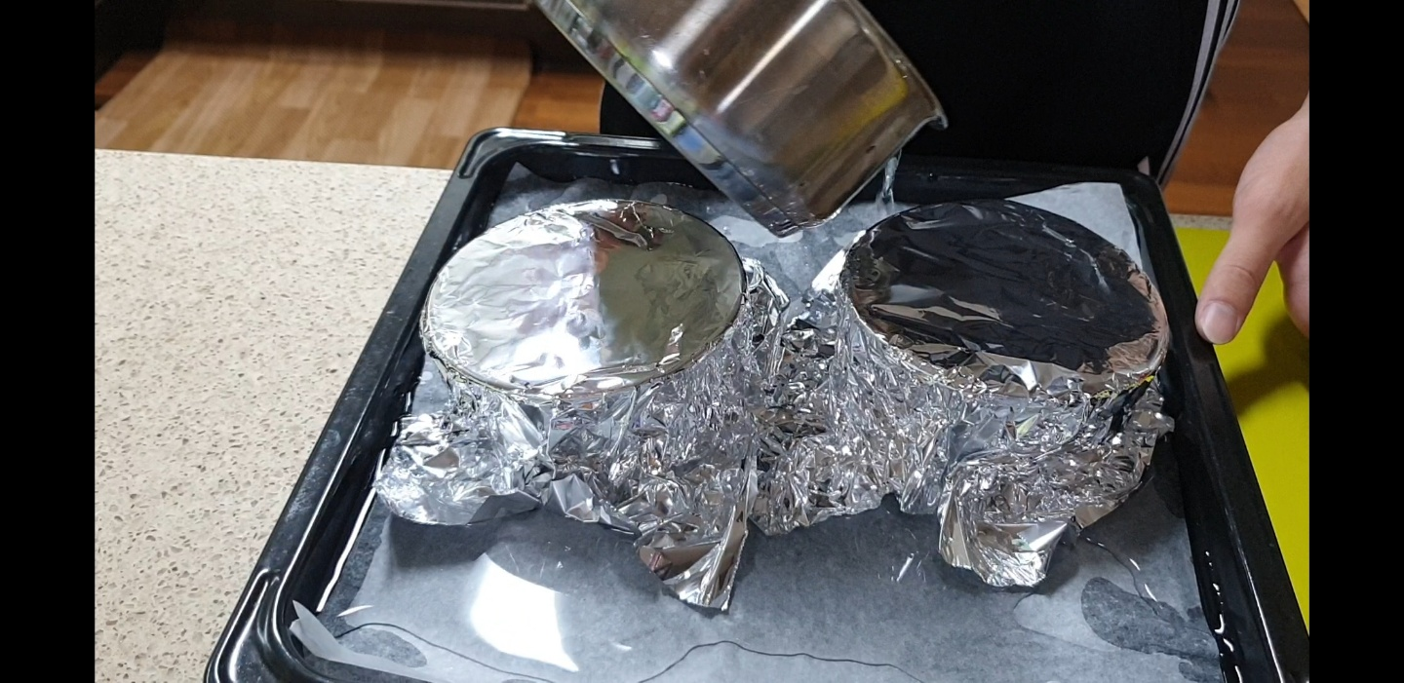
Add hot water.

Slide 27
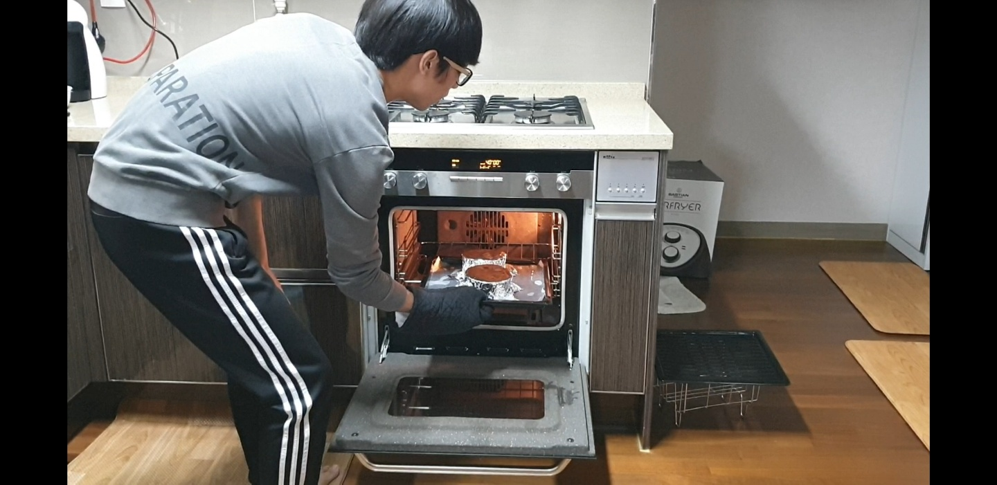
Bake in the oven.

Slide 28
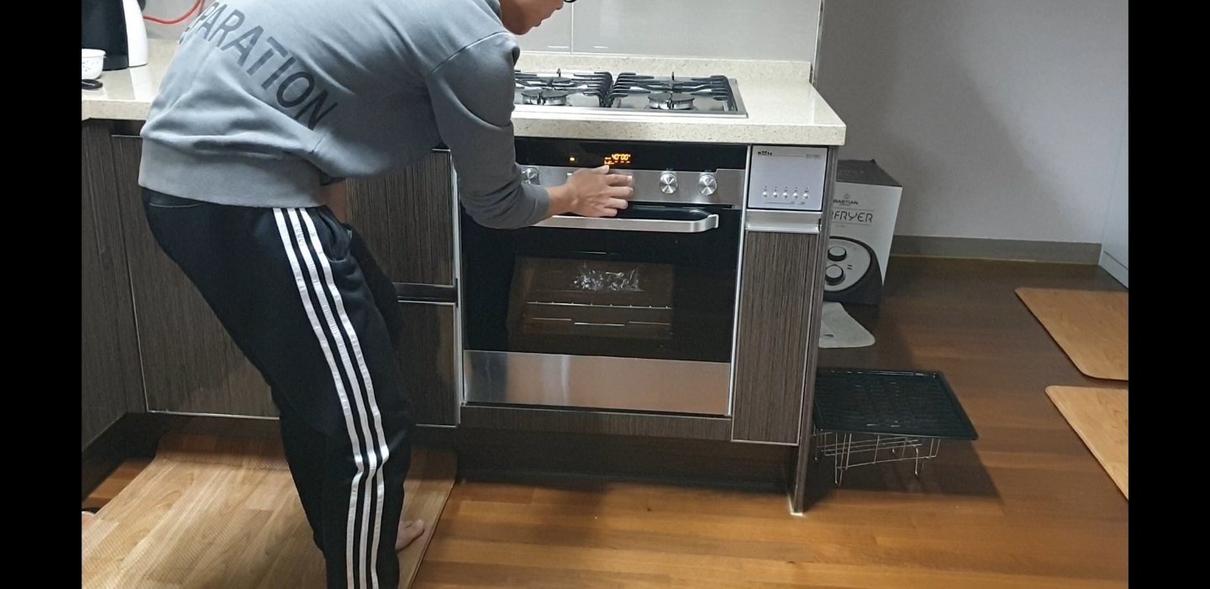
Bake in the oven.

Slide 29
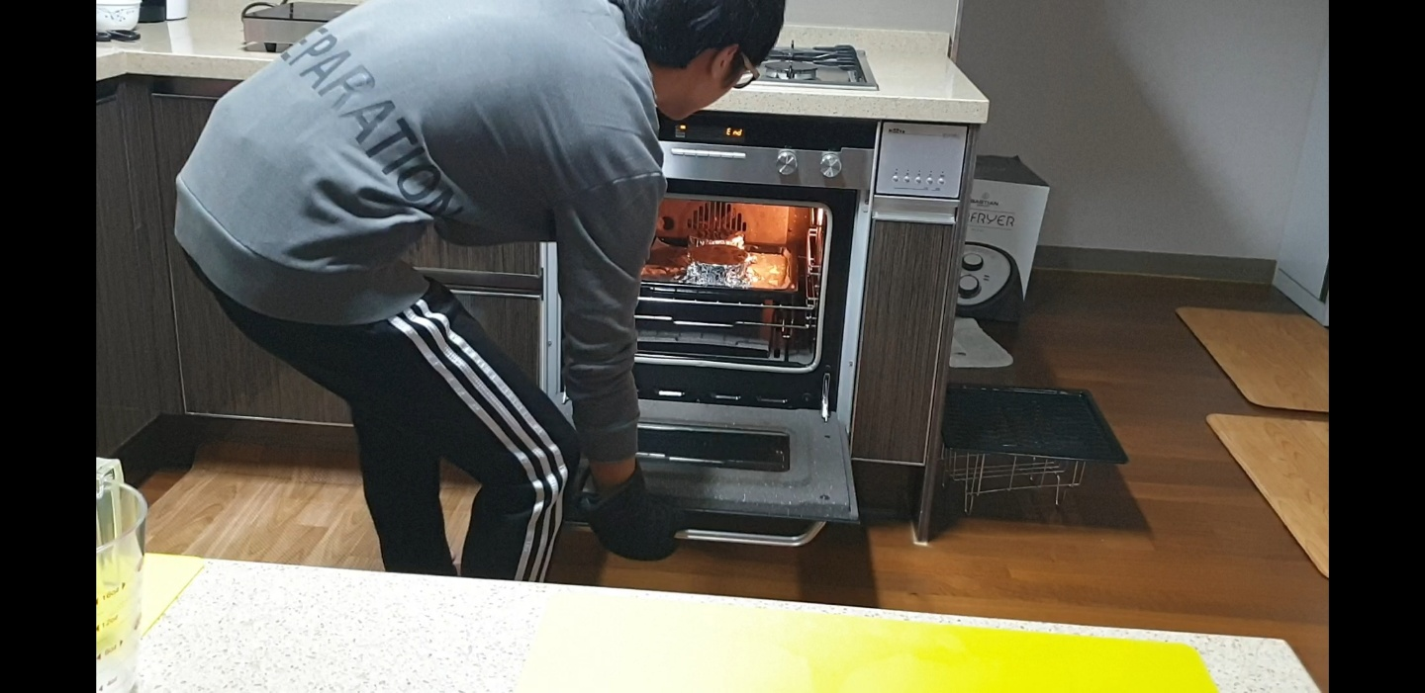
Cool and chill in the fridge.

Slide 30
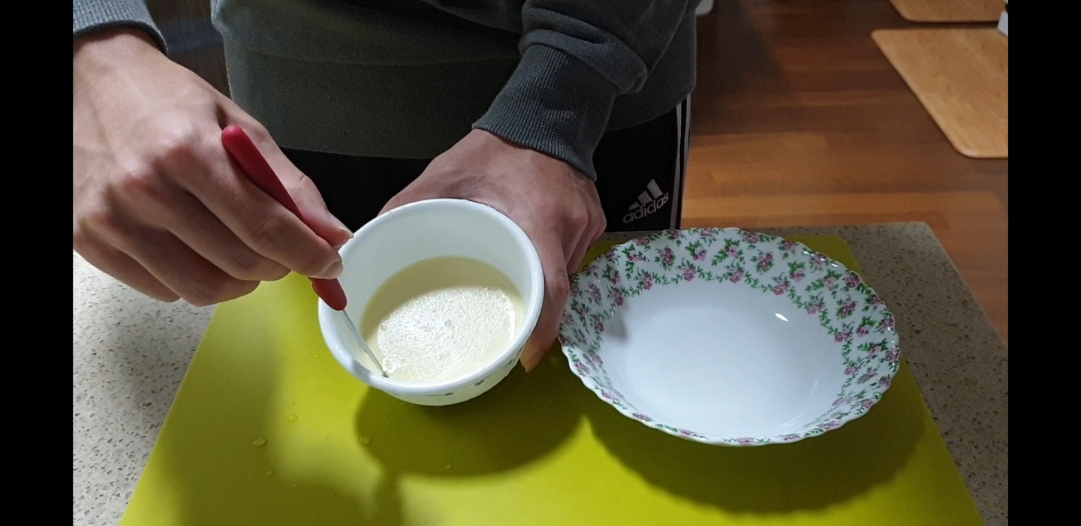
Cut the pudding.

Slide 31
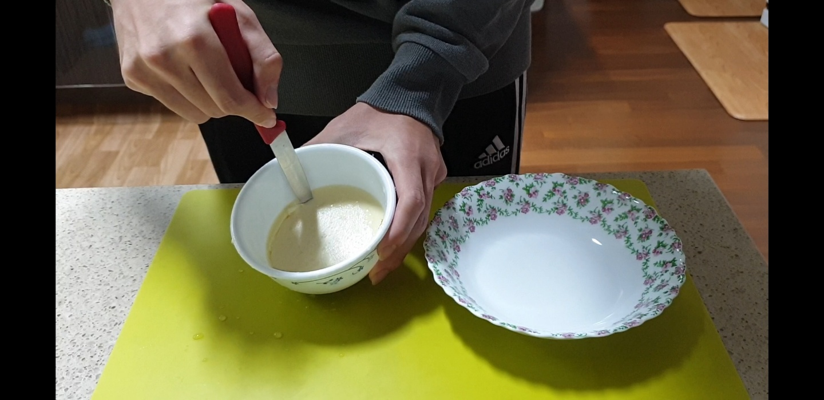
Cut the pudding.

Slide 32
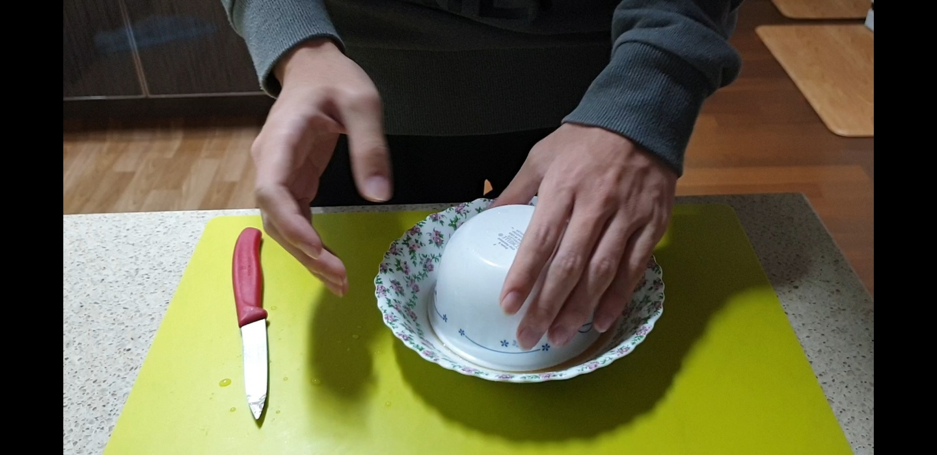
Turn it upside down get it out.

Slide 33
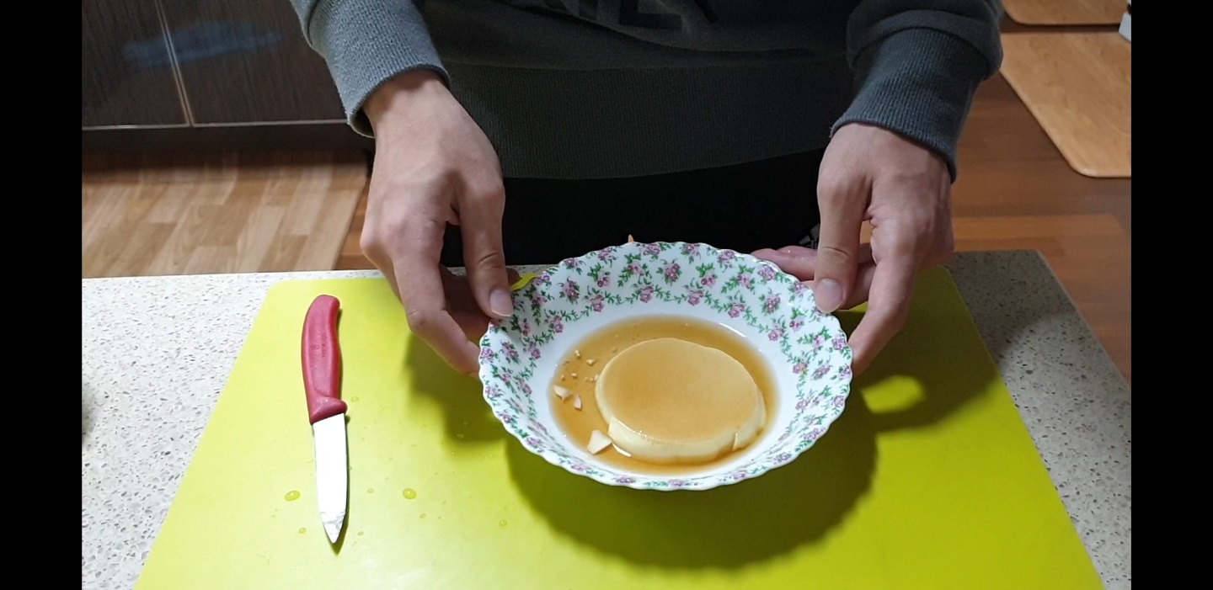
Now, we can eat delicious pudding.

Slide 34
Reference
Cooking tree youtube
https://youtu.be/c1ROUg6rOGs

